Slide 1
AI Agents for Computational Chemistry
Christopher McClendon
Senior Principal Scientist, Pfizer
October 20, 2026
Discngine Meetup Vol. 6
GitHub: chris-lee-mc, Christopher-Lee-McClendon
linkedin.com/in/christophermcclendon
Christopher.L.McClendon@pfizer.com

Slide 2

Overview
Introduction
Why AI Agents for Computational Chemistry
Best Practices and Lessons Learned
From 15 months of using AI Agents to do Computational Chemistry
Example Showcase
Workflows and results developed with AI Agents
The Future
What’s next and what we can build at the speed of thought
Image credit: Disney, YouTube

Slide 3

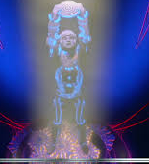
Introduction
What is an AI Agent?
Unlike a simple script, an Agent is autonomous.
- Perceives: Reads the user's prompt and workspace context.
- Reasons: Decides which tools are needed.
- Acts: Executes tools, reads files, runs calculations.
-Reports: Summarizes, makes plots, images, docx, report
"I fight for the users!" — TRON

Slide 4
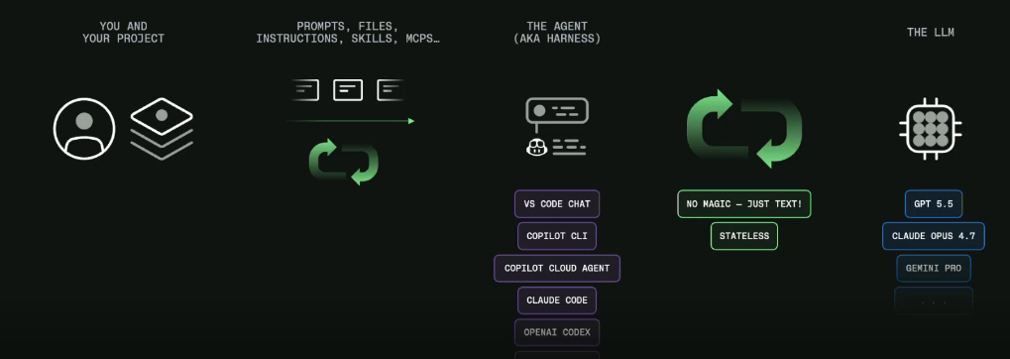
Agent Skills AND TOOLS
Tools: LLM model writes JSON strings that indicates what code should be run with what inputs and what parameters, etc. Often very general-purpose.
Skills: Cookbooks. Bundles of instructions, prompts, examples, code snippets, full-blown scripts, data, etc. that Agents can add to context window as-needed. Can be broad or specific. Lower overhead than tools but slightly less deterministic.
Coding agents can be used to orchestrate computational chemistry calculations (more than writing scripts)
"All my functions are yours.“ - MCP
Image Credit: GitHub

Slide 5

Best Practices and Lessons Learned
General-purpose Coding Agent Harnesses
Enterprise multi-agent systems
Managing robots and Context Engineering
Fine Control vs. White-Glove
Bleeding Edge Dev vs. Concierge Experience

Slide 6

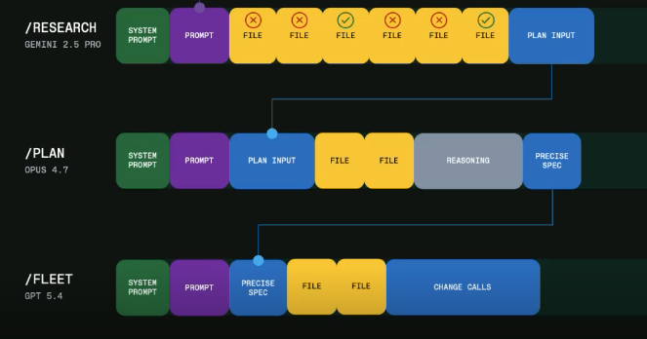
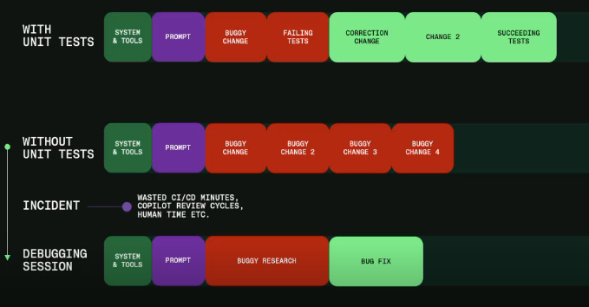
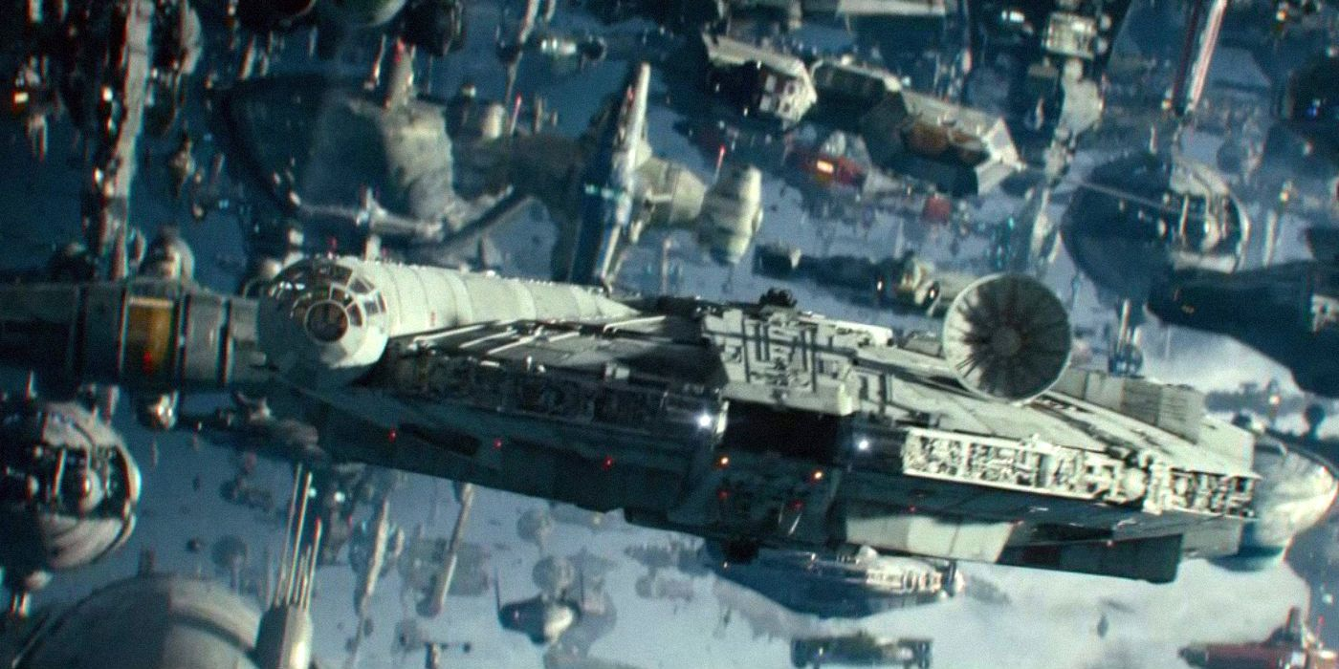
Better Quality CODE:
Spec-Driven Development
TEST-Driven Development
Multi-AGENT WORKFLOWs
Spec-driven development
Red-Green Test-Driven-Development
Image Credit: GitHub
Image Credit: GitHub
Power prompt words: provenance, red-team audit, semi-formal reasoning
Example Multi-Agent Coding Workflow: https://github.com/ShepAlderson/copilot-orchestra

Slide 7

Workflow Maturation
Prompt – Macguyver a workflow together –
high token cost due to figuring things out on the fly and iteration
Skill – Reusable agent instructions –
code snippets, etc. Should reduce LLM token cost as it is prod-tested and refined
Tool – Deterministic Code for established
procedures – token cost only to orchestrate, monitor, AI review of output
This process can be automated with the right goals, specs, examples, and evals …
… need Human-in-the-loop prod testing
"On the other side of the screen, it all looks so easy." — Flynn

Slide 8
Example Showcase
AI-assisted Benchmarking and AutoResearch
Computational chemistry method development
Iterative Molecular Design (e.g. MOE Medchem Transformations
Managing robots

Slide 9
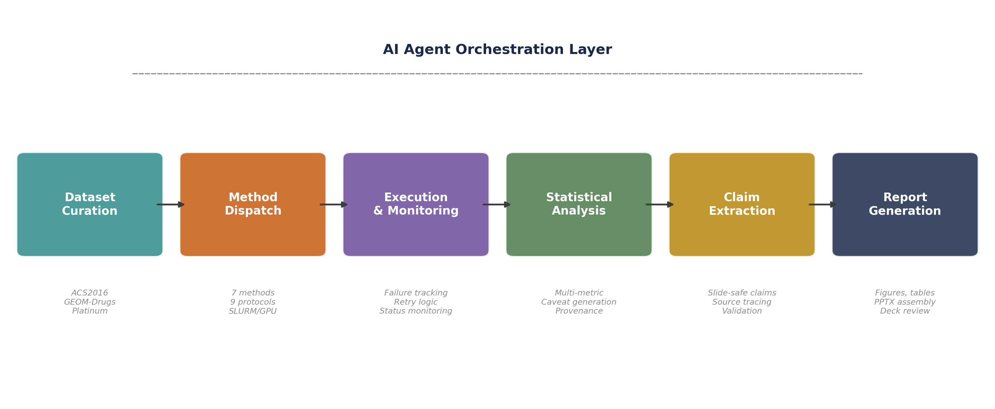
Why AI-assisted Benchmarking?
• Rapid development and testing of new protocols at scale
• Manual benchmark campaigns are time-intensive and may not be easily repeatable
• AI-agent orchestration: automated dataset curation → method execution/refinement → statistical analysis → reporting
• Coding agent can fix problems and continue where typical deterministic methods would fail and give errors. User doesn’t need to do the time-consuming grunt work of debugging each benchmark system.

Slide 10
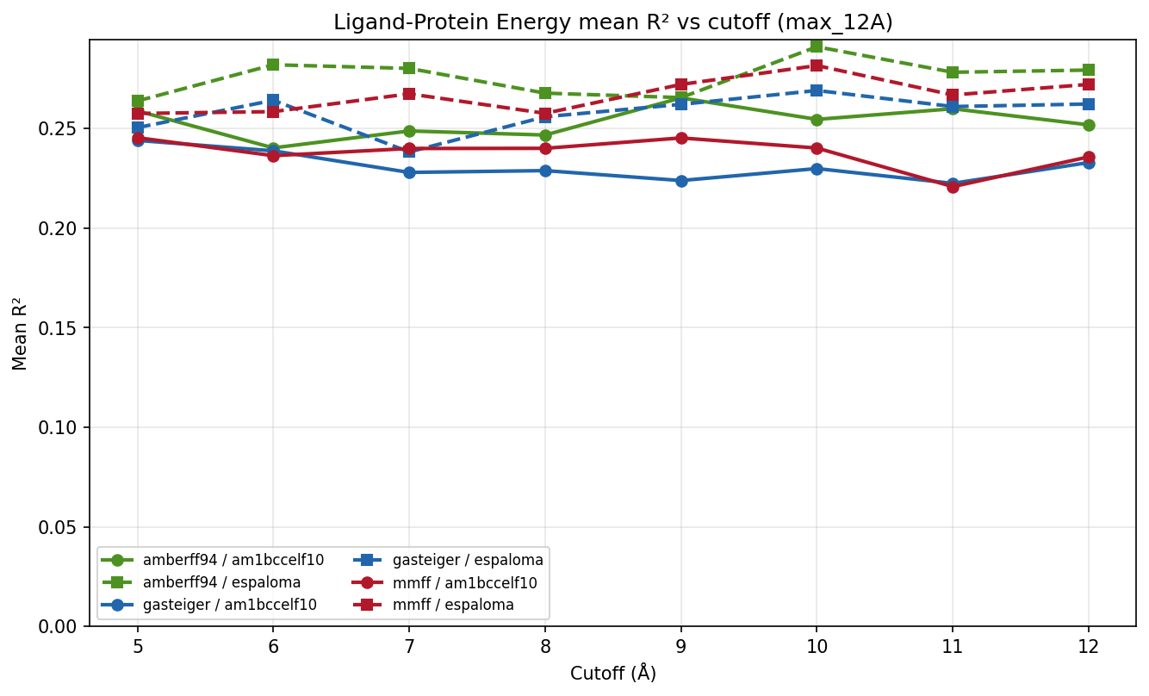
MM-PBSA Hyperparameter
AutoResearch Loop
The AutoResearch approach was used for exploring different protocols and settings to try.
However, a later pass with cleaned up system prep was used
in final calculations
┌─────────────────────────────────────────────────────────────────────────────┐
│ AI AGENT LOOP │
│ │
│ 1. MODIFY experiment_config.sh ← Parameters: FF, cutoff, charges, elec │
│ ↓ │
│ 2. DISPATCH run_experiment.sh → 52 parallel SLURM jobs (cpu partition) │
│ ↓ │
│ 3. EXECUTE score_system.sh → MM-PBSA + ZING per system (~2 min each) │
│ ↓ │
│ 4. EVALUATE evaluate.py [FIXED] → Parse SDF tags, compute R²/ρ/τ │
│ ↓ │
│ 5. LOG experiments.tsv → Experiment registry + JSON archives │
│ ↓ │
│ 6. VISUALIZE make_heatmaps.py → Heatmaps, parity grids, comparisons │
│ ↓ │
│ 7. ANALYZE → Identify root causes → Inform next round parameters │
│ │
└─────────────────────────────────────── REPEAT (R1→R4) ─────────────────────┘

Slide 11
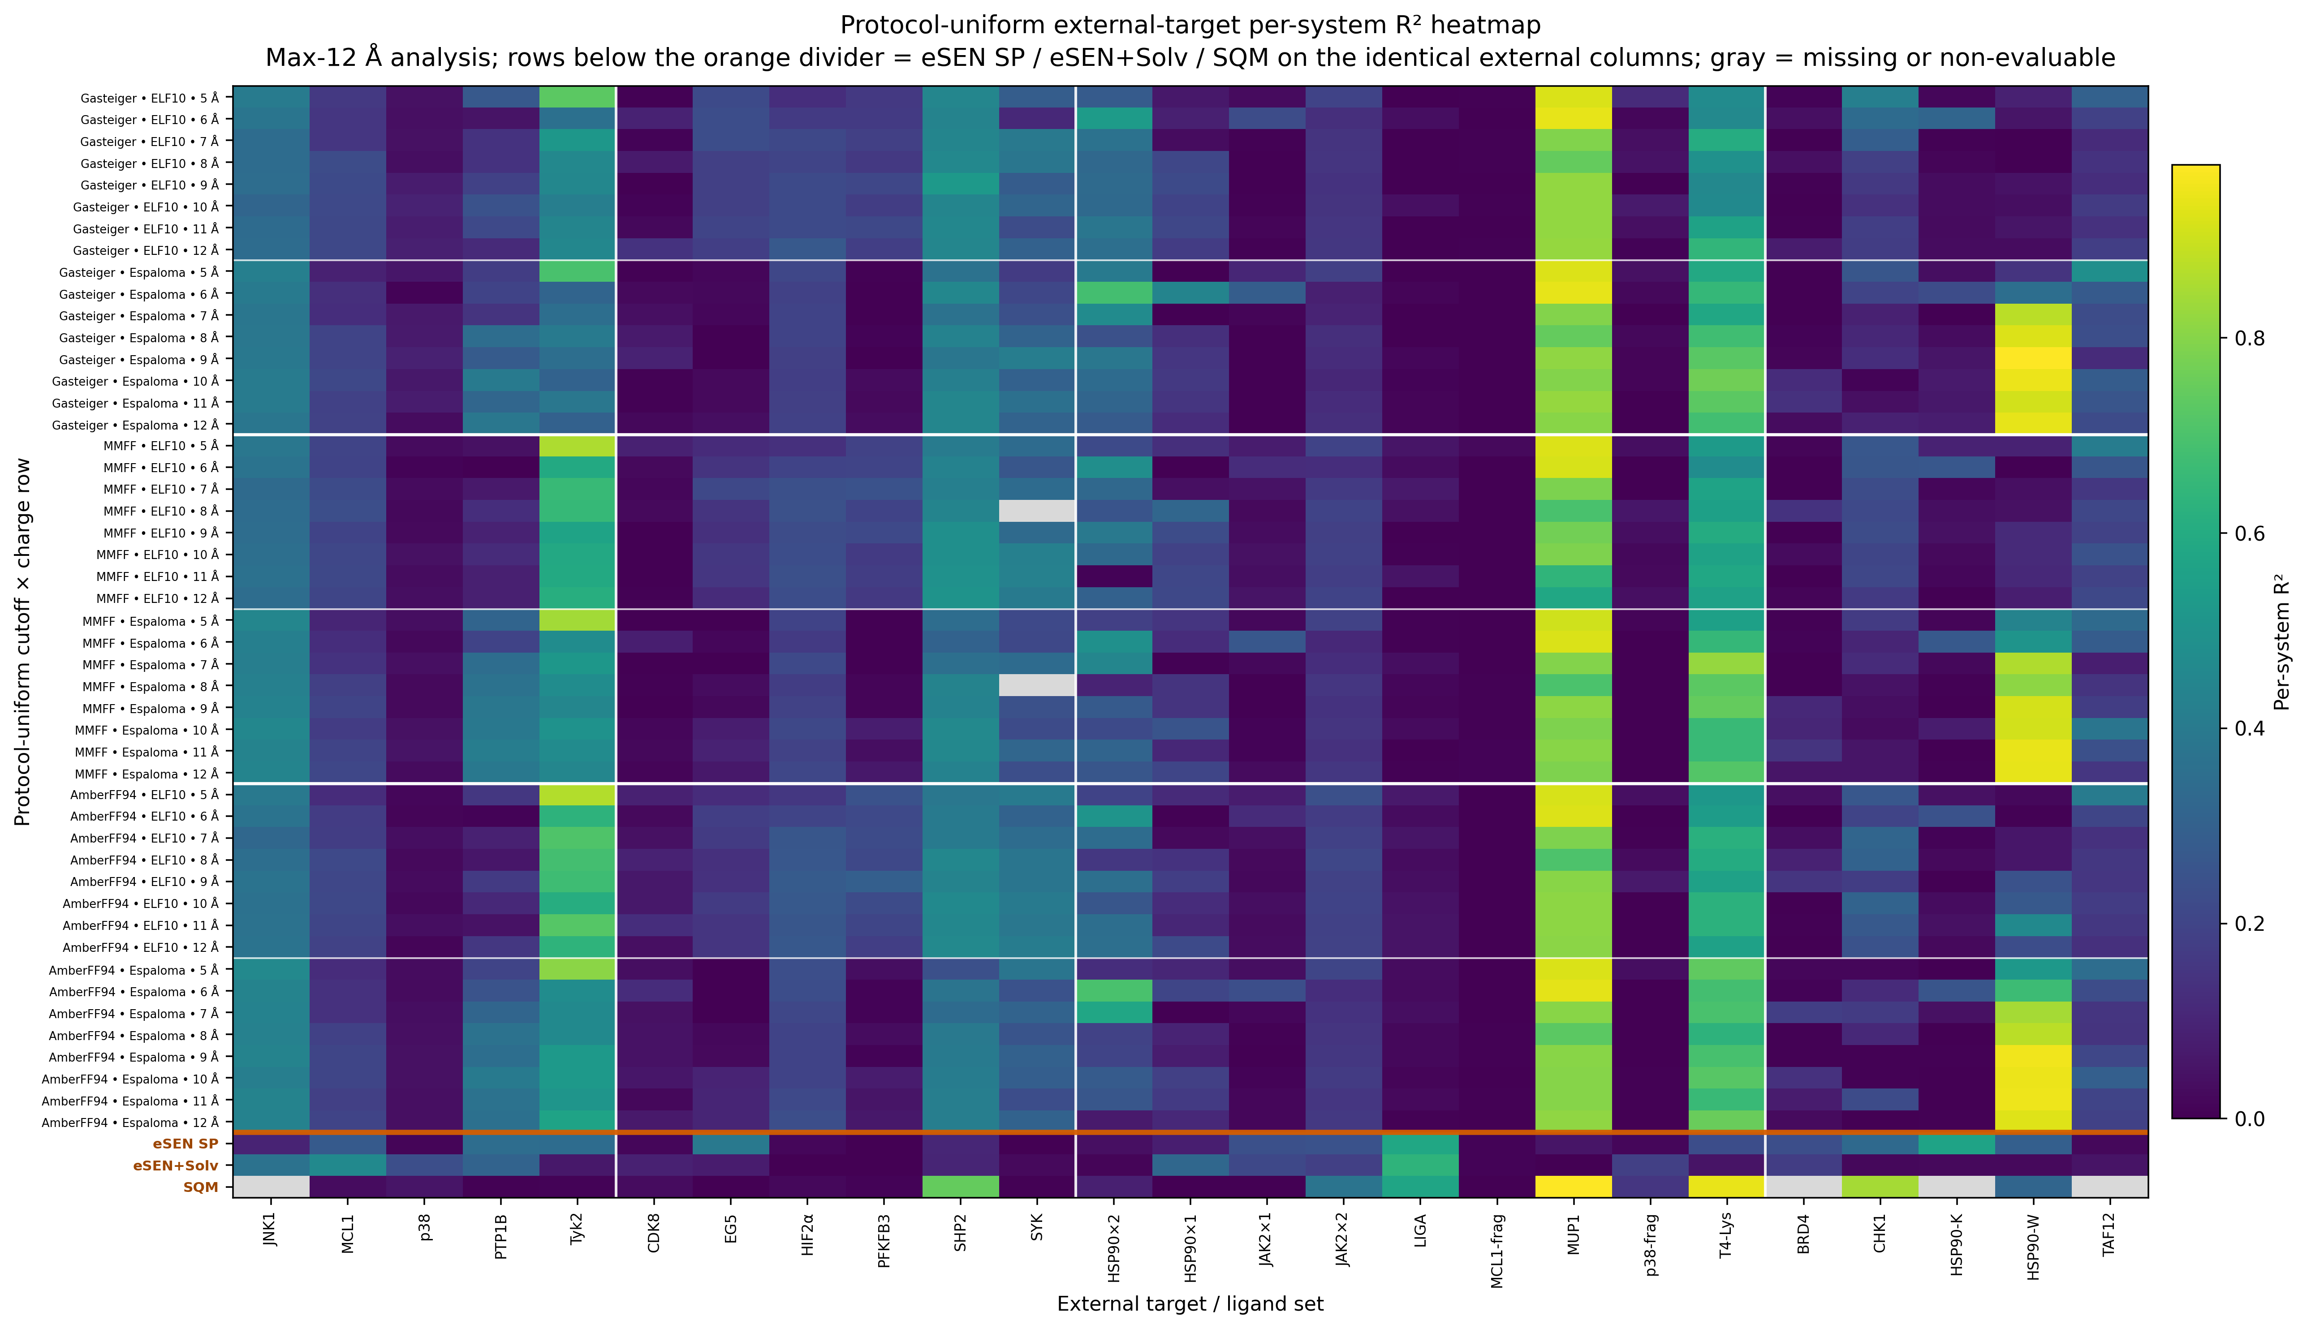
MM-PBSA R² potency prediction: varying cut-off distance and partial charges
SQM needs more per-system care. SQM or eSEN might help rescue cases where SZYBKI fails

Slide 12
Hyperparameter Optimization Recommendation for a new target
1. Benchmark locally
2. Choose by evidence
3. Recheck on updates
Run a small per-target panel over cutoff, protein-charge model, and ligand-charge model using the user’s receptor conformation and ligand series.
Pick the setting with the best target-specific rank and regression behavior, not just the global mean winner.
Repeat when the protein conformation, ligand chemotype, assay endpoint, or charge/protonation assumptions change.
Take-home: some methods work better for different systems, so the scientifically defensible default is per-experimental-complex benchmarking.
Updated external-target deck generated from the 2026-06-02 protocol-uniform study.

Slide 13
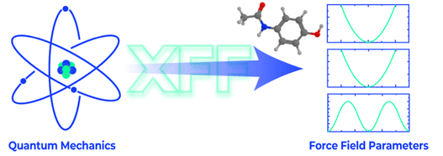
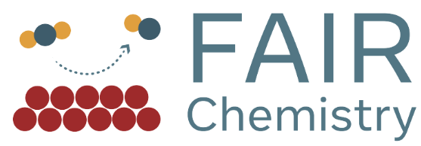
Single Point Energy Comparison on ACS2016 Scans
• ACS2016 Torsion Fragments: 2,204 drug-like fragments (Sellers et al. 2017)
• QM reference: B3LYP/6-31G* -> MP2/cc-pVTZ
(Xue et al. 2024)
• 15° grid, 24 points per scan
Method | N pts | RMSE | MAE | R | Barrier RMSE | Minimum Match
UMA | 46,536 | 1.57 | 0.78 | 0.910 | 2.76 | 59.1%
XFF3.0 | 46,536 | 1.48 | 0.90 | 0.888 | 2.20 | 48.0%
OPLS3e | 46,536 | 1.61 | 0.93 | 0.871 | 2.27 | 52.9%
ANI-2x | 46,536 | 1.79 | 1.05 | 0.875 | 2.85 | 52.9%
GAFF2 | 46,536 | 3.29 | 1.76 | 0.672 | 5.50 | 40.4%

Slide 14
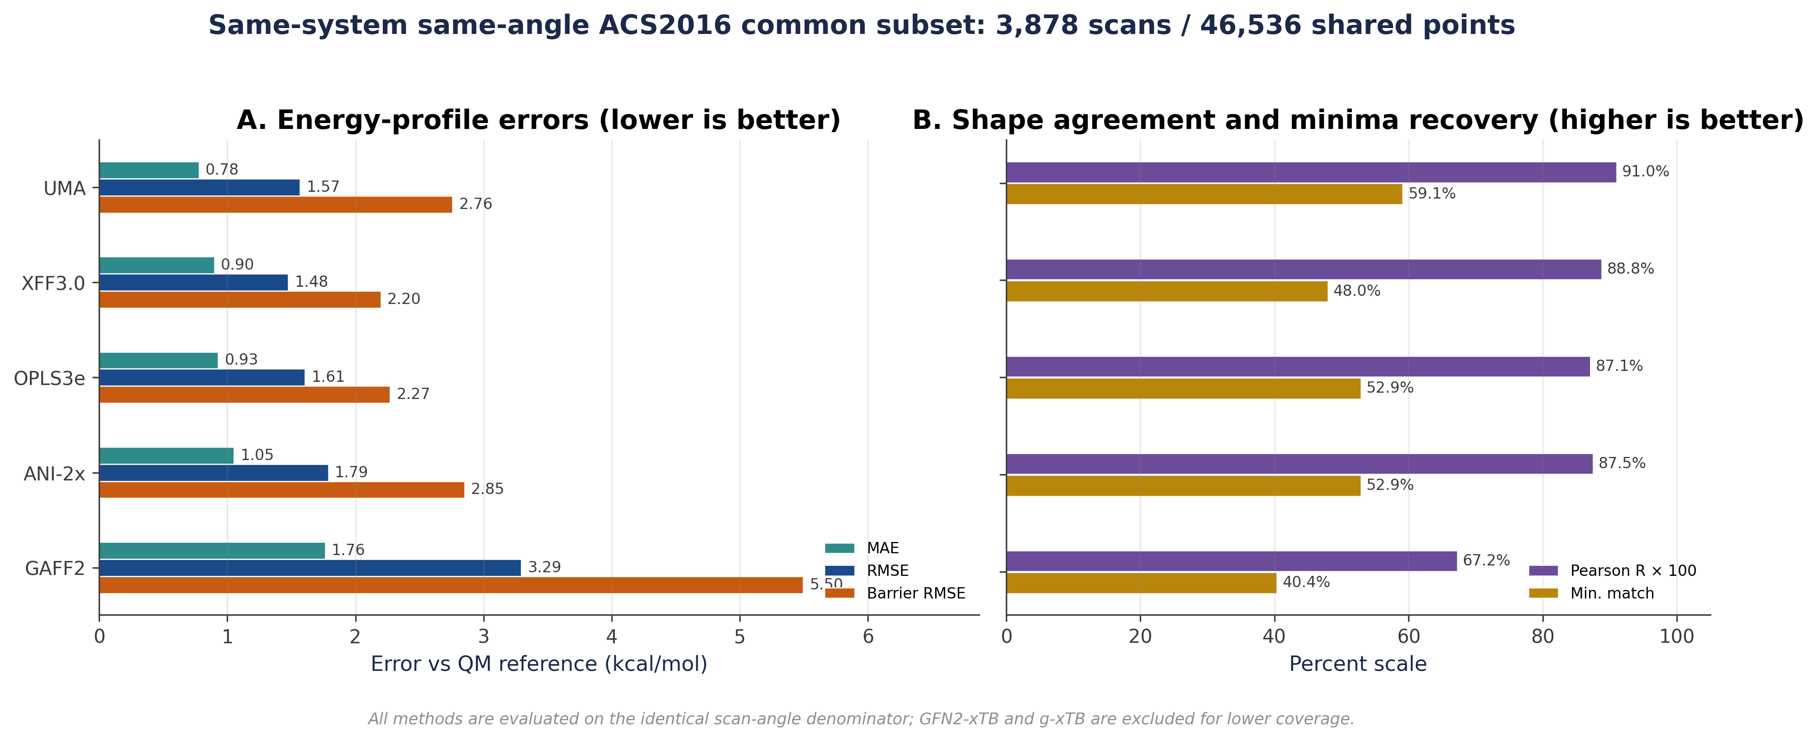
XFF provides competitive fragment dihedral scan single point energies

Slide 15
AI-assisted Conformational Sampling
Method Development
• GitHub Copilot assisted development of pfGOAT based on literature global optimization method
• ORCA-like conformational sampling protocol followed by minimization with XFF and optionally Meta FAIRChem eSEN
• GEOM-Drugs: CREST GFN2-xTB conformer ensembles (Axelrod & Gómez-Bombarelli 2022) + internal QM (r2SCAN-3c) for single point re-ranking
• Platinum Diverse: crystal-structure-derived geometries (Friedrich et al. 2017)

Slide 16
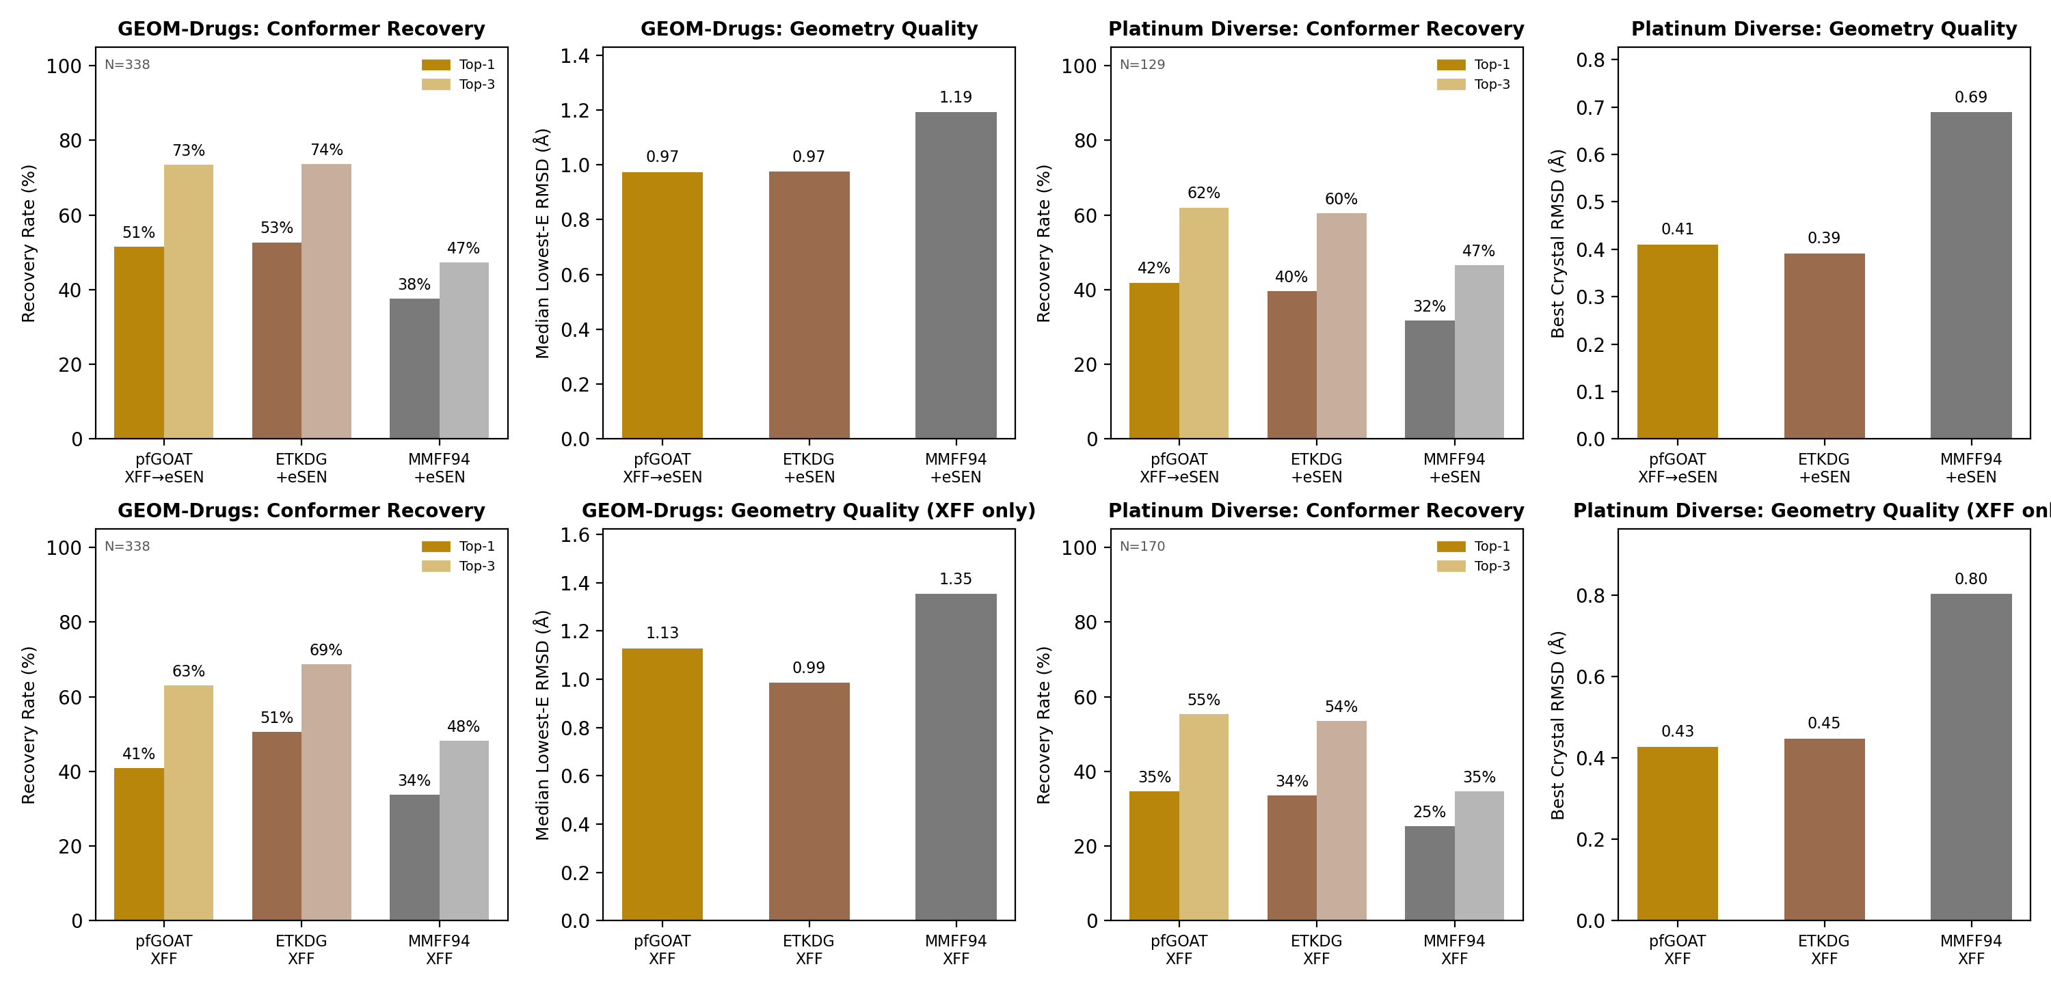
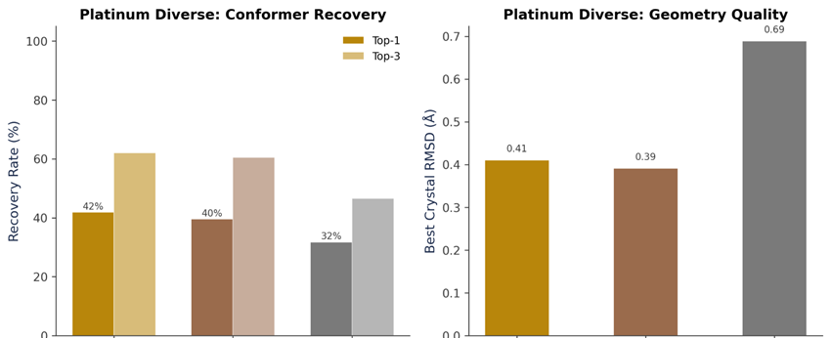
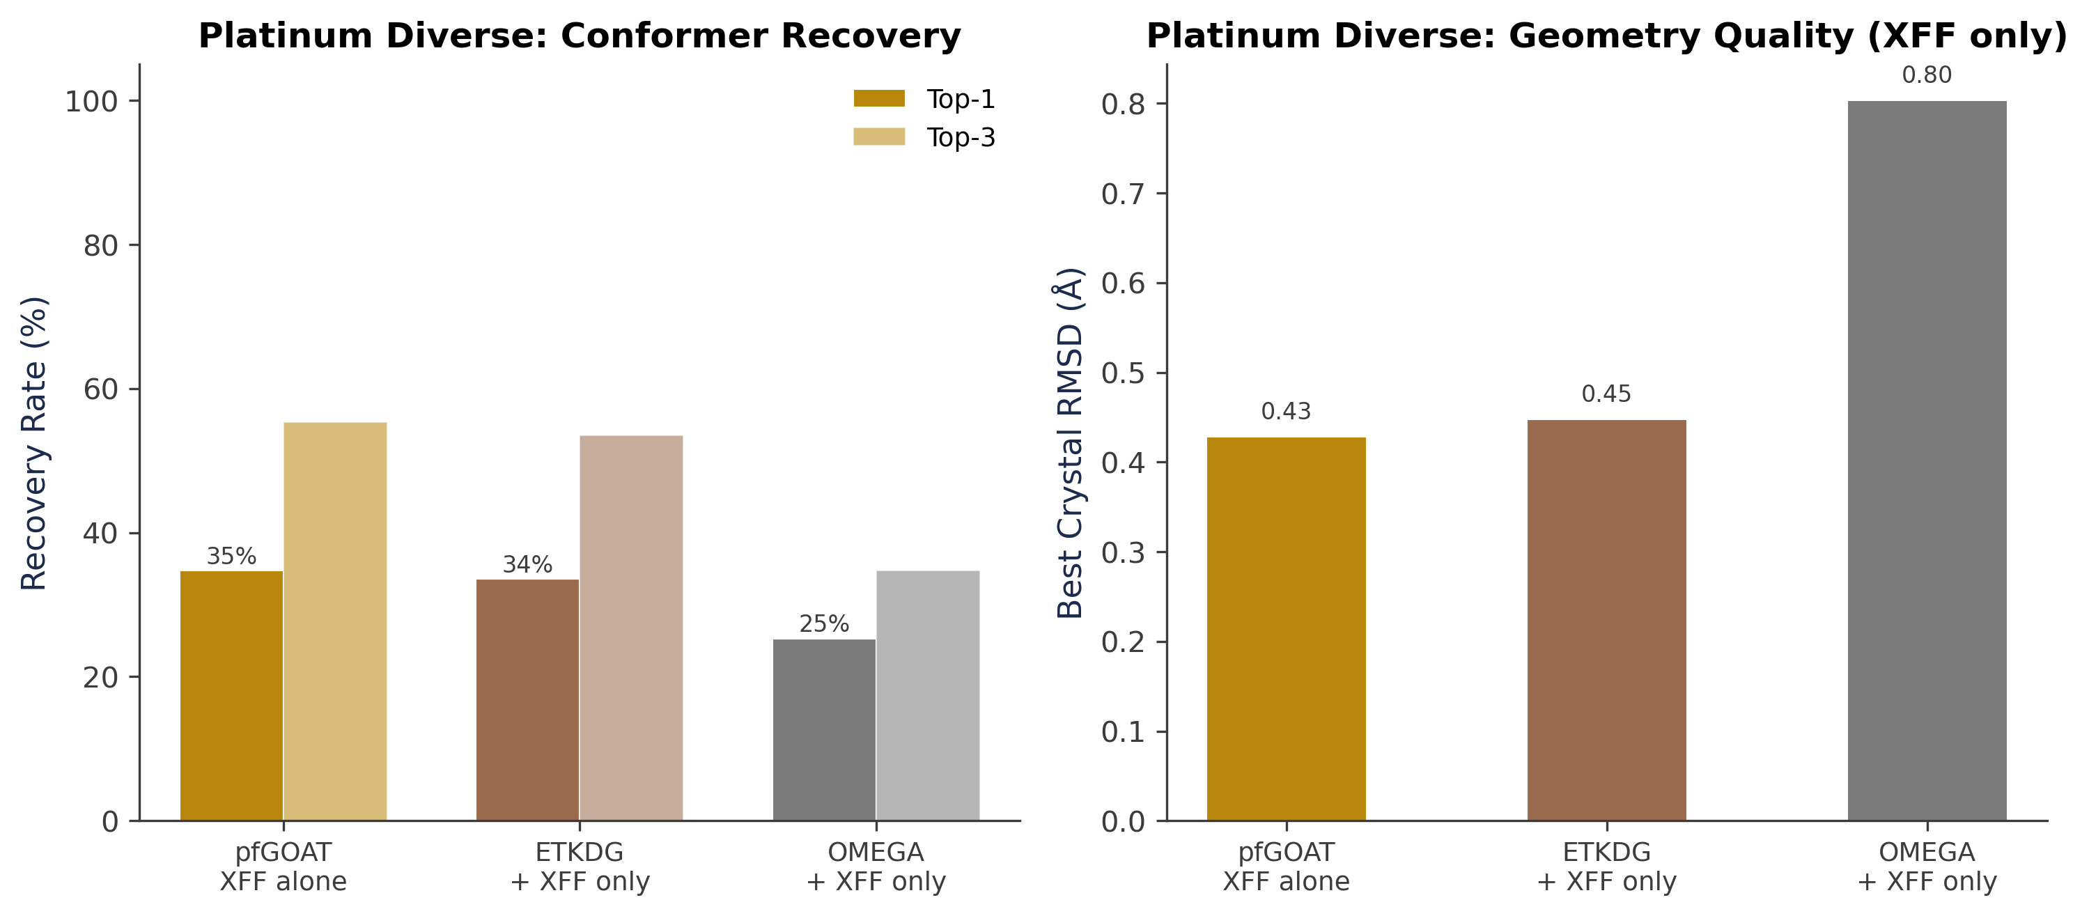
ETKDG Sampling with XFF and eSEN rescoring shows comparable performance to pfGOAT
• GEOM: ETKDG+eSEN slightly leads top-k recovery (83.7/96.2%) but pFGOAT XFF→eSEN has lower mean MAE (1.021 vs 1.159)
• Platinum: XFF→eSEN has best top-1 (41.9%); ETKDG+eSEN is close (39.5%) and has the lowest mean crystal RMSD
pgGOAT
XFF->eSEN
EDTKG
+eSEN
MMFF94+eSEN
pfGOAT
XFF->eSEN
EDTKG
+eSEN
MMFF94+eSEN
pfGOAT
XFF->eSEN
EDTKG
+eSEN
MMFF94+eSEN
EDTKG
XFF
MMFF94+XFF
pgGOAT
XFF
MMFF94+XFF
pfGOAT
XFF
EDTKG
XFF
MMFF94
XFF
MMFF94
XFF
MMFF94+eSEN
pfGOAT
XFF
EDTKG
XFF

Slide 17
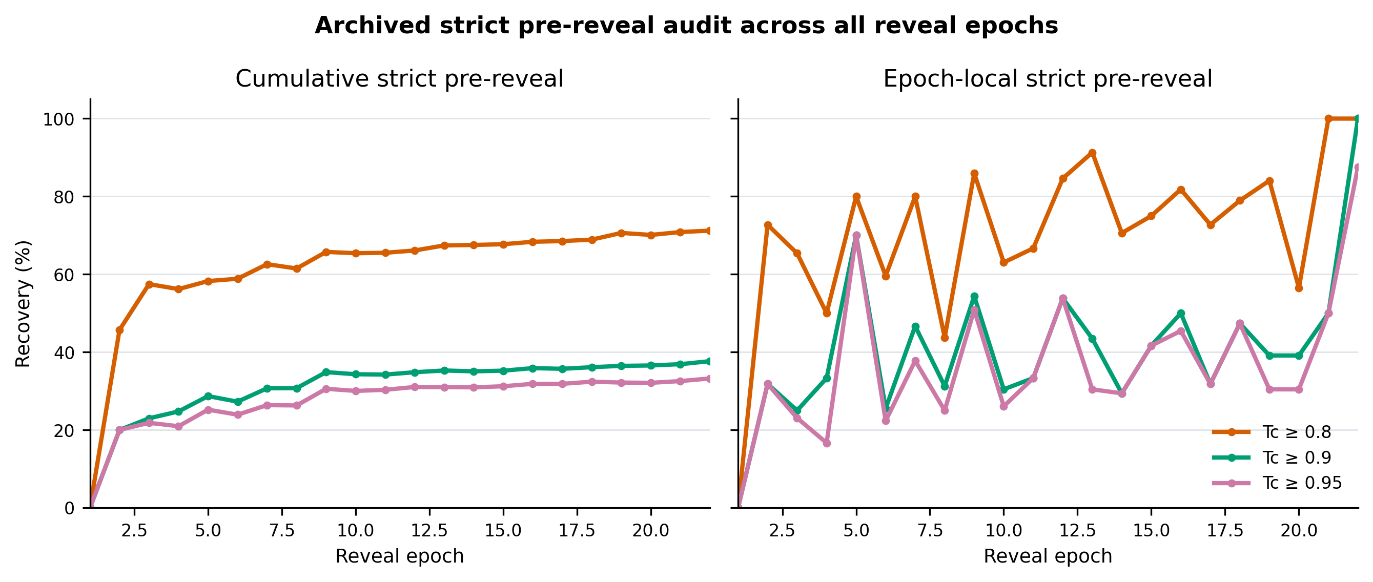
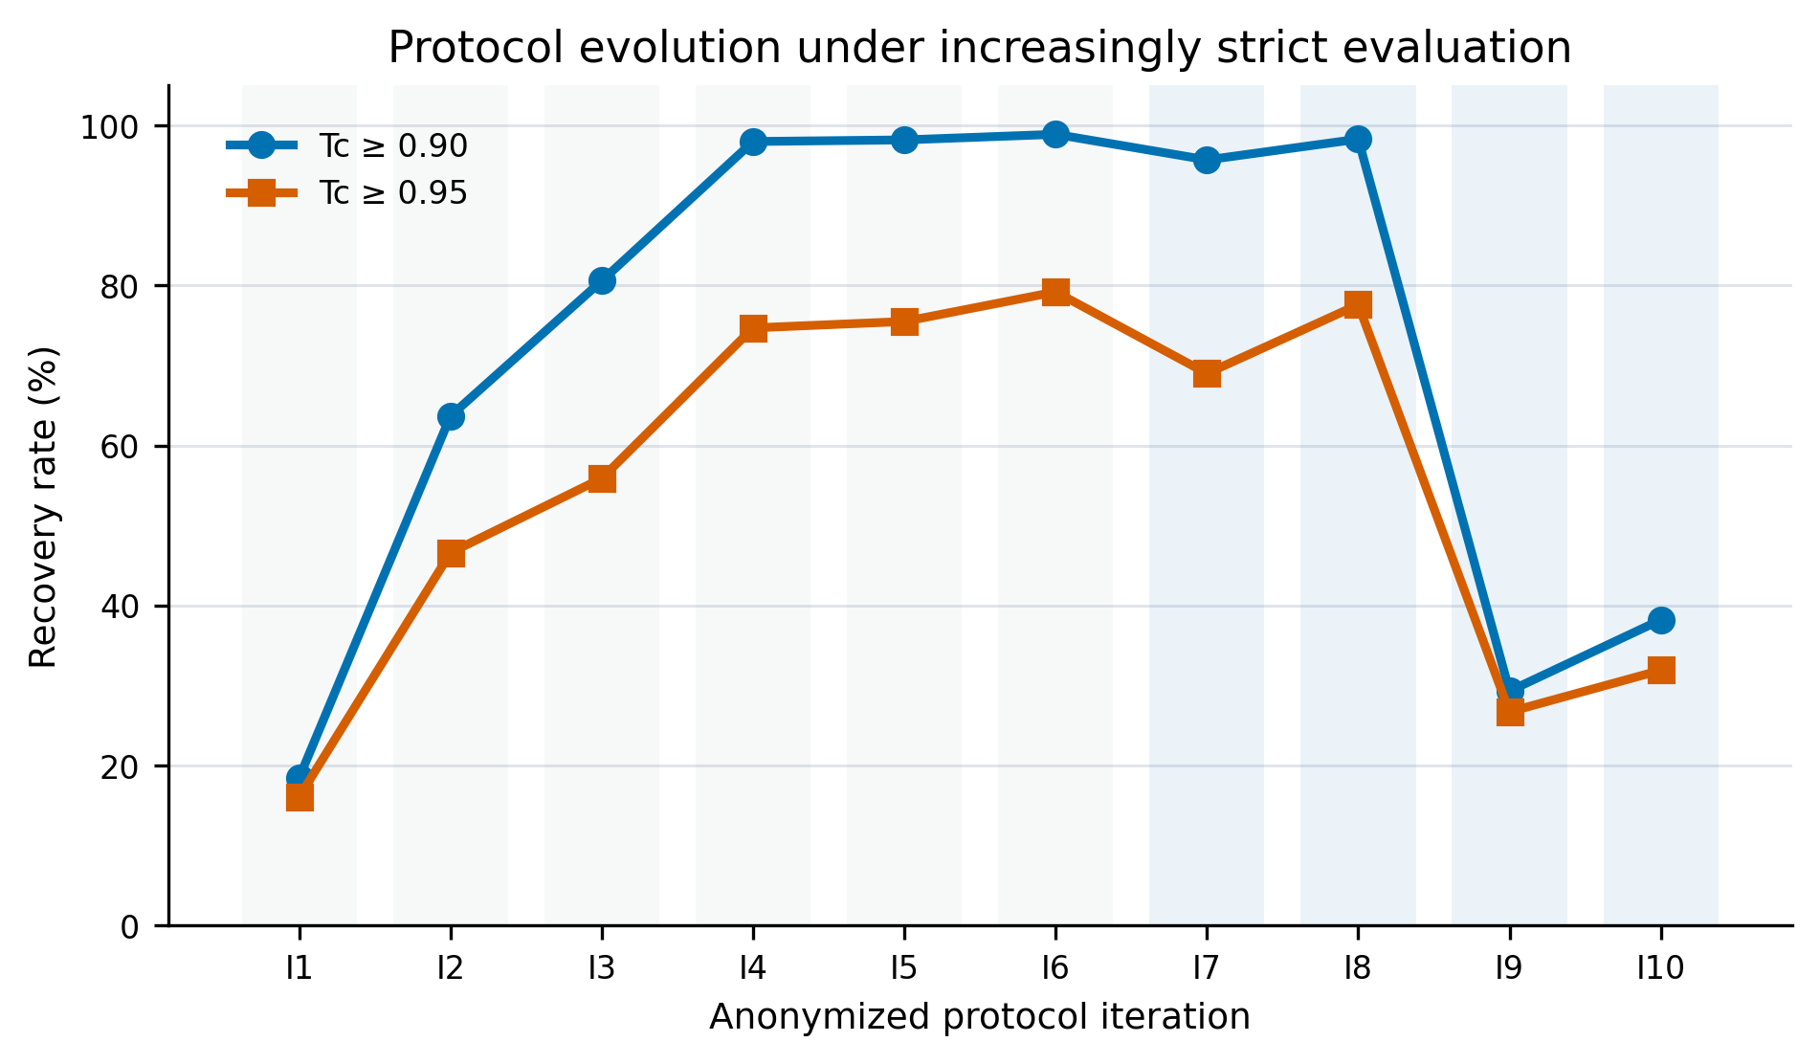
pfDesign – Autonomous Molecular Transformations
Autonomous ligand transformation protocol built with GitHub Copilot with semi-automated AutoResearch
Lesson Learned: In pursuit of optimizing something, LLMs can find creative ways of data leakage – need reminders
1
Seed
2
Generate
3
Reveal
4
Score
5
Repeat
Known compounds available before the reveal point
Multiple transform/scaffold-hop passes propose analogs
MOE Medchem Transformations + MedChemMoves + BROOD
Next temporal batch is treated as unseen target set
Nearest-neighbor similarity to generated analogs
Cumulative recovery tracked across epochs
Removed data leakage

Slide 18

The Future
E2E Design Agents
Self-Improving Agent Harnesses
New compound ideas with full compchem packages
Be careful of giving the agent credit cards (cloud FEP)
Analyze chat histories
modify system prompts and toolsets/skills of sub-agents
memory consolidation (dreaming)
e.g. Google Harness2
Always-On Agents
Agent Swarms
Compchem OpenClaw
Listen for new data
Act on new data as it comes in
Calculations, reports and visualizations ready the next morning
Reading lots of log files
Attention to each step of the calculation for each ligand
Beyond AutoResearch – Evolutionary Code Optimization
(Google Alpha Evolve, OpenEvolve )
Pfizer 2026 | Confidential and Proprietary

Slide 19

Acknowledgments
Joy Yang
Phillip Hudson
Mayur Khanna
Shane Wierbowski
Emmanuel Ehmki
Dac-Trung Nguyen
Heather McNamee and the Pfizer GitHub team
chris-lee-mc
Christopher-Lee-McClendon

Slide 20
Thank You

