Slide 1

Towards
AI collaborators in drug discovery
Samuel Genheden
Molecular AI, Discovery Sciences, R&D, AstraZeneca, Gothenburg, Sweden

Slide 2
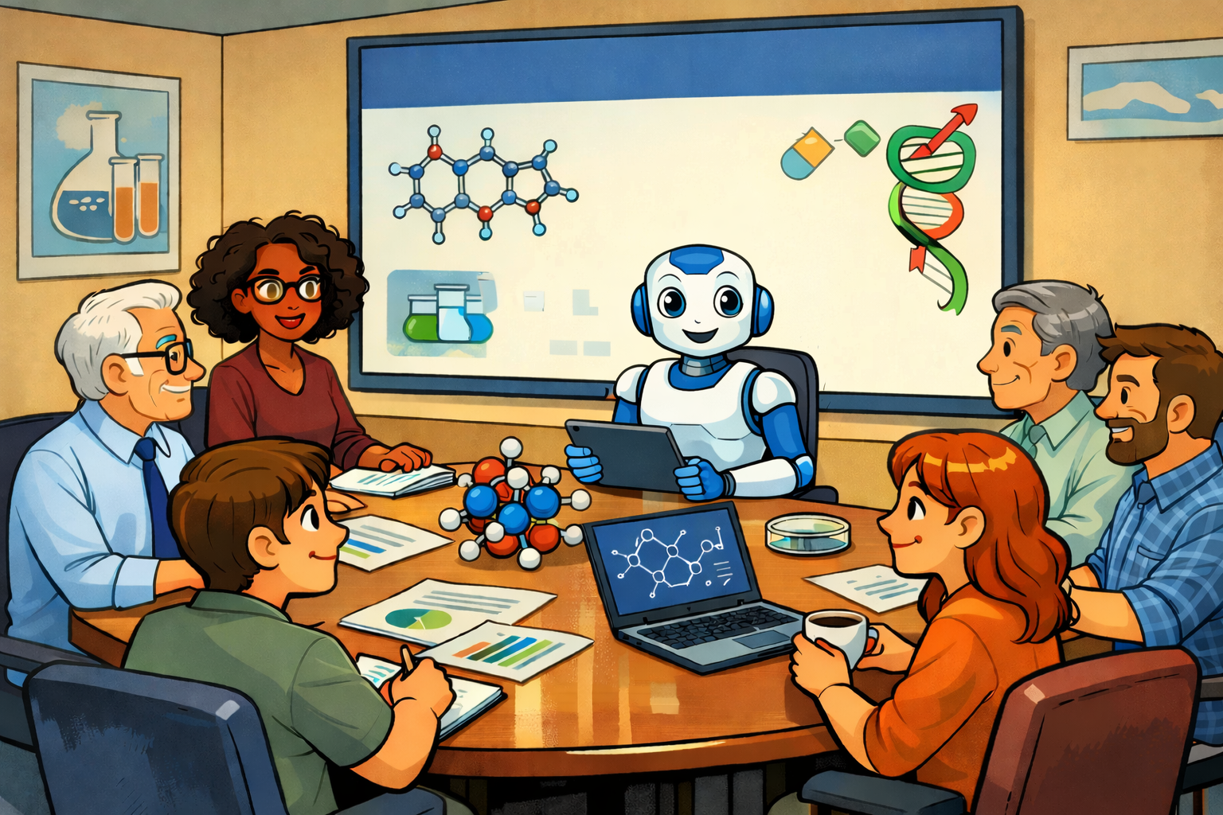
Here are some ideas that I have generated based on the available data

Slide 3
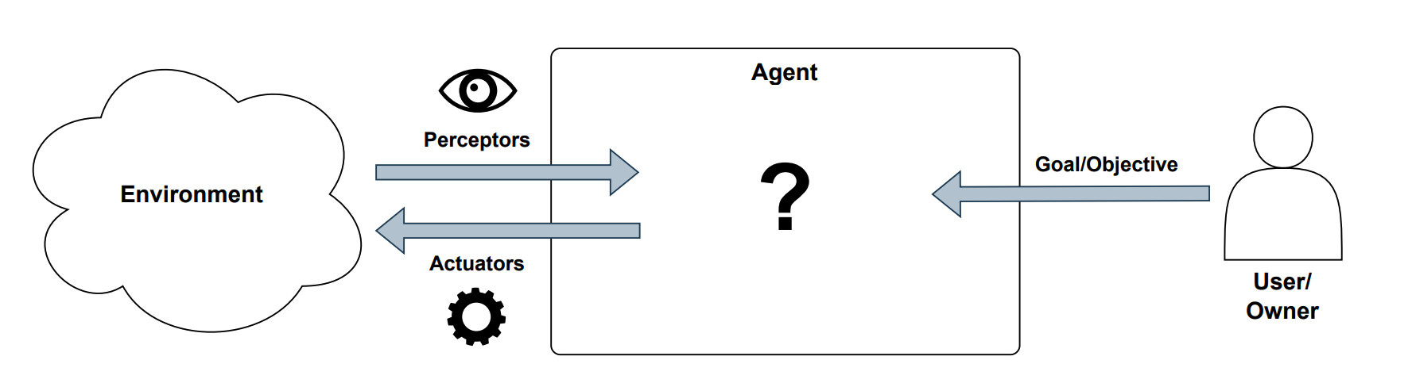
Definition AI agent
No agreed definition!
Perception: gathers information from its environment through sensors or data inputs
Learning: adapts over time by learning from experiences or new data
Reasoning
Control
Planning
Learning
Action: execute tasks that influence the environment or achieve objectives
Decision making: process information to make informed decisions using algorithms or learning models

Slide 4
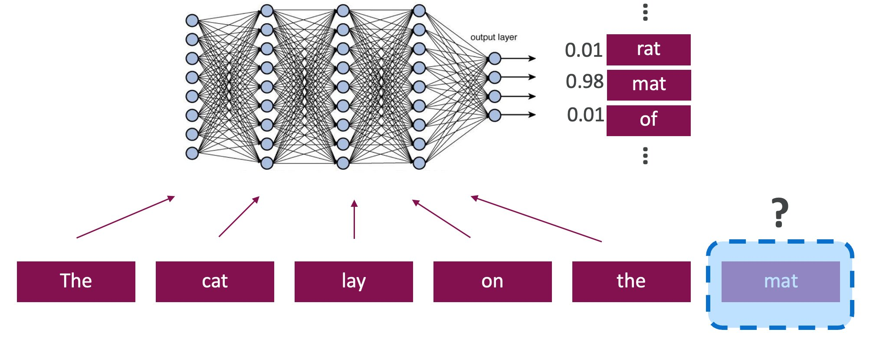
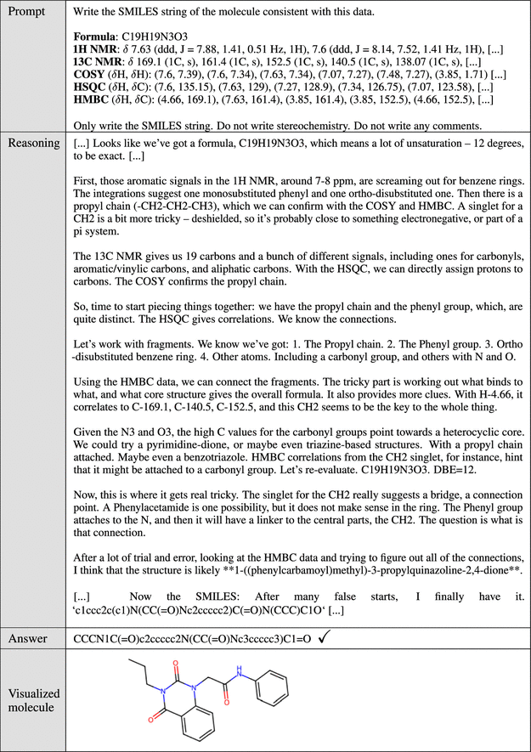
Large language models
Foundation models trained on massive amount of data
Good at a variety of tasks
  Summarization
  Code generation
  Etc
Promise is that they can reason about chemistry and make decisions
J. Chem. Inf. Model. 2026, 66, 1, 216–227

Slide 5
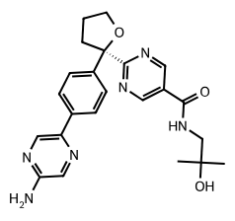
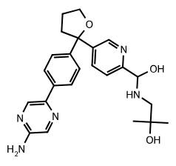




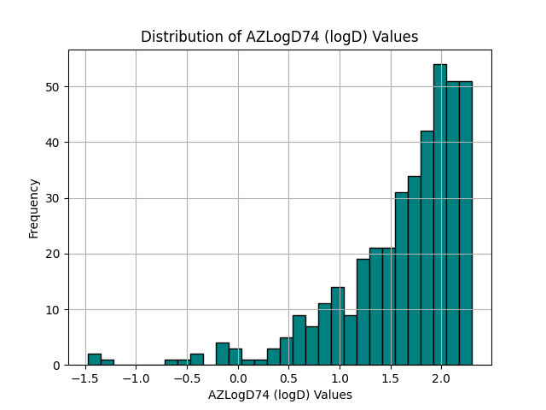
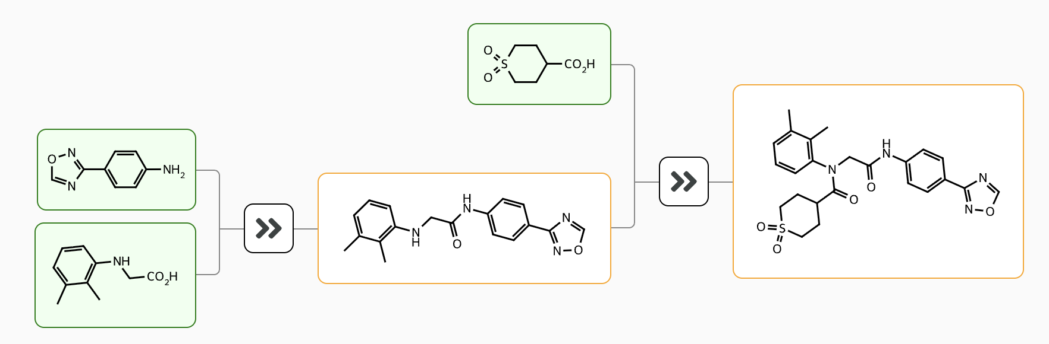
Agents Enable Drug Design with Natural Language
Can you provide some compounds similar to AZC5642 but with lower lipophilicity?
Drug design with natural language
AZlogD74 1.54 1.94 2.63 2.82
Can you show me the distribution of lipophilicity for the novel compounds?
Agents
Showing a histogram for the column AZLogD74
Conversational – not only Q&A
Co-pilots easily accessible
How can I make the novel compound with lowest lipophilicity?

Slide 6

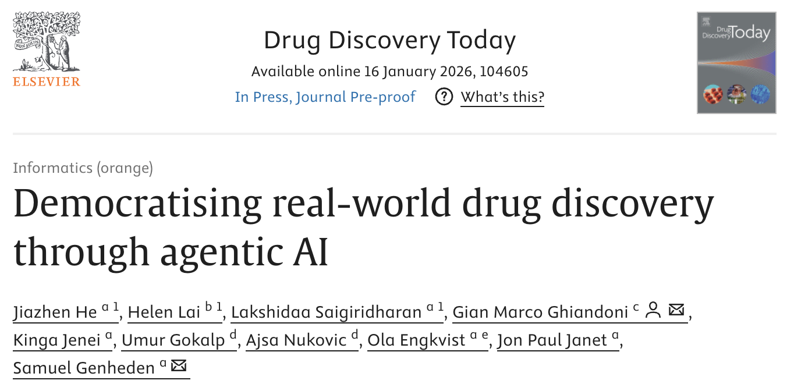





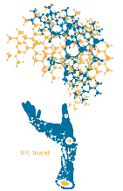



ChatInvent – an agent for chemistry
Web application
Agent software
Track, debug,
evaluate
APIs
APIs
LLM
Tools & DBs

Slide 7

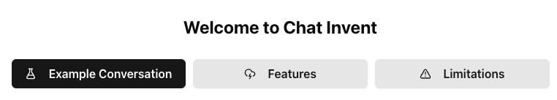
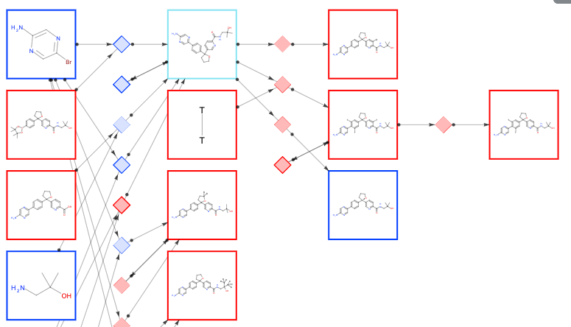
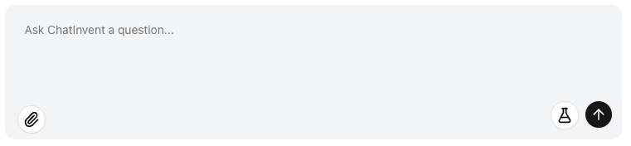

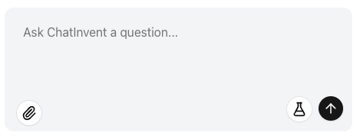

An Evolving Modular Agentic Ecosystem for Chemistry
Reuse agents
in several application
Interfaces
GUI
agent
Click button
Fill-in box
Agents
Design
Agent
Synthesis Agent
Utility
Agent
Data Agent
SAR
agent
Extended capability
by slotting in agents
MolFormer
LibInvent
LinkInvent
ReInvent scoring
AiZynth Finder
Precedent Finder
Synonyms
Validation
Chemical awareness
Search project
Create
Python
Clustering
MMP
SAR
Docking setup
Tools
Library enum.
Notes:
MCP = model context protocol
A2A = agent 2 agent

Slide 8
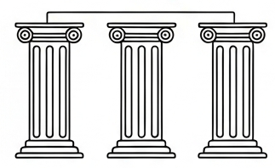
Infrastructure Readiness for Agentic Systems
Agent performance is bound by the quality and accessibility of underlying software and databases
Three Critical Pillars
API Maturity
Data & Schema Consistency
Architectural Flexibility

Slide 9

API (Application Programming Interface) Maturity
API maturity directly impacts both development speed and system reliability
Stability
Agent Facing Error Logging
Documentation
  API errors can propagate across multi-step reasoning workflows
  This limits our ability to validate orchestration performance end-to-end
Clear, actionable error logging enables intelligent failure handling
Well documented API accelerates delivery

Slide 10
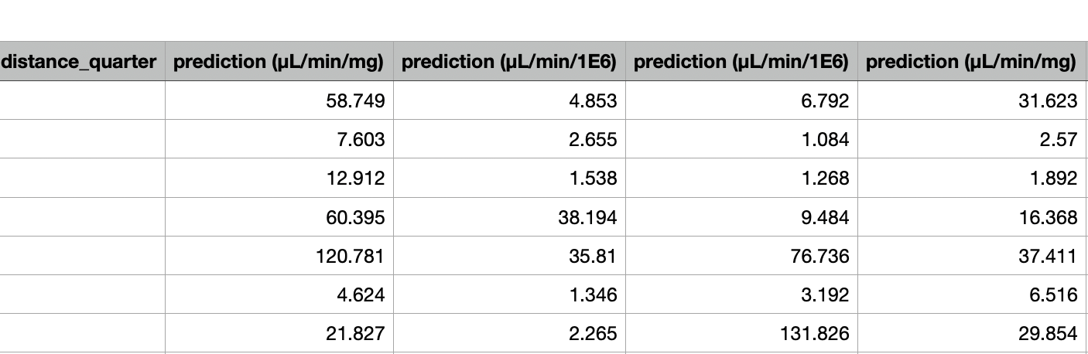

Consistency of data
How are these predictions different?
Shall I ignore it?
Database design must account for LLM/agent consumption, not just human interpretation
Clear, consistent naming conventions are critical for correct usage
Mental model for what these predictions are

Slide 11


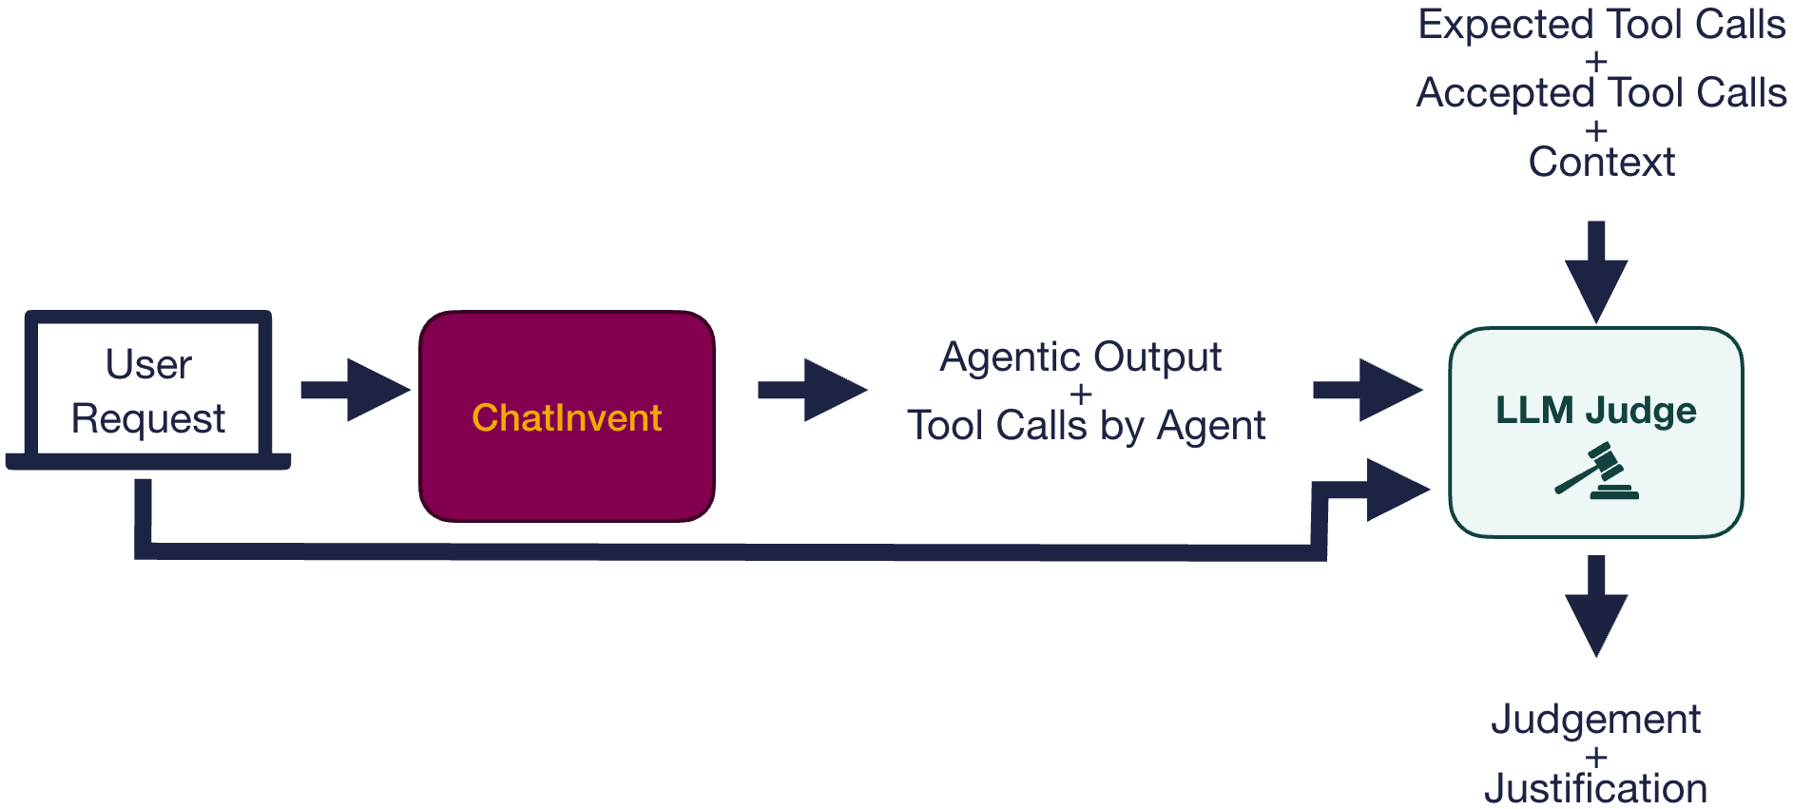
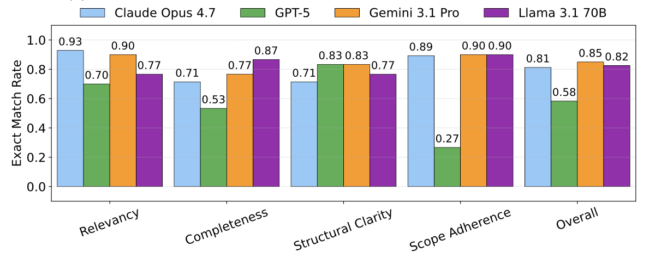
Evaluating agent performance
Emma
Granqvist
Rocio
Mercado
Criteria
Tool call correctness
Completeness
Structural clarity
Relevancy
Scope adherence
Important to evaluate human alignment!
100 questions were semi-automatically generated
5 human experts rated the same agent output as the LLM on a subset of the questions

